Slide 1


Predicting energy consumption at an hourly frequency for San Diego Gas & Electric (SDGE) utility region

Slide 2
Problem statement
Electricity cannot be stored in large amounts, so supply and demand should always be matched.
Load/energy demand forecasting is fundamental for an energy utility’s decision making mechanism to avoid:
- Grid failures or Wastage of energy
- Costs of under or over cutting
Notes:
- The energy companies need to know how much energy to produce at any given time to avoid grid failures or wastage of energy.
- Costs of under- or over-cutting are high in an energy balancing market which can lead to huge financial losses for an utility.
- They cannot pass their cost to the customers.

Slide 3
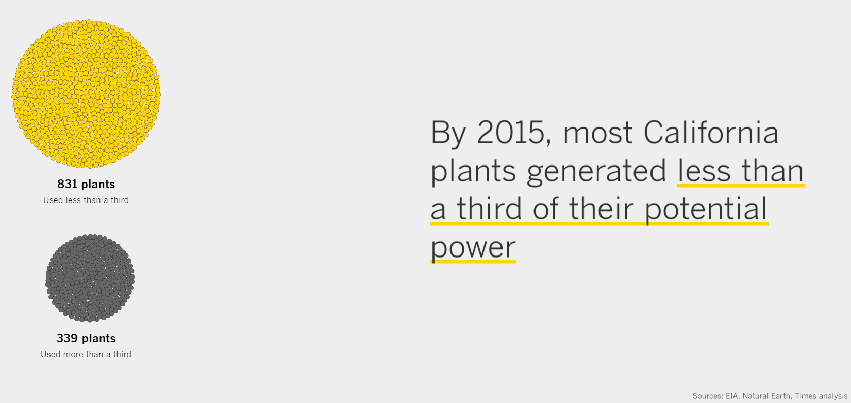
https://www.latimes.com/projects/la-fi-electricity-capacity-graphic/
Notes:
https://www.latimes.com/projects/la-fi-electricity-capacity-graphic/

Slide 4
Goal
Electrical utilities can use the forecast to :
Effectively plan their energy generation operations and balance the demand with appropriate supply.
Meet their customers’ energy demand, and avoid excess generation of energy.

Slide 5
Load forecasting
Load -> Demand (in W) or Energy (in Wh)
For hourly data they are the same
The peak or maximum load decides the capacity of power plant

Slide 6
Process flowchart
Importing data
Hourly energy data
Sub-hourly weather data
PV installation data
Data /cleaning/wrangling
Data /cleaning/wrangling/resampling
Data /cleaning/wrangling/resampling
Extracting features
Extracting features
Adding features
Merge
EDA
Preparing data for ML models, Feature engineering, define error metrics
ML models training & testing and comparing results

Slide 7
DATA

Slide 8
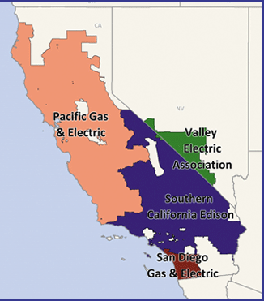
Energy Data
California Independent System Operator (CAISO)
- Data link1, link2
We’ll focus on SDGE (San Diego Gas and Electric) utility for this project.
Small area serves better chance to use uniform weather data.
San Diego has high enough population and good distribution of residential and commercial customers.

Slide 9
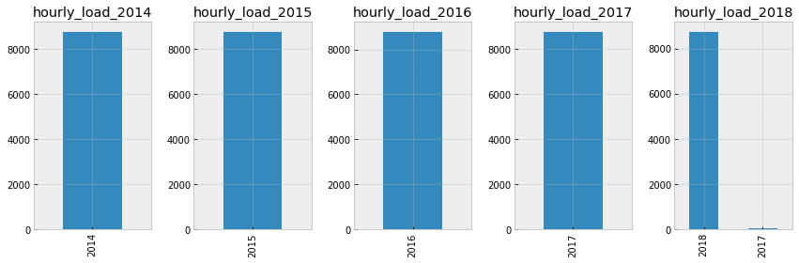
Energy Data Cleaning
Data imported directly from URLs and stored in pandas dataframes.
Data cleaning and formatting done with the help of data visualization (see below) and Descriptive stats.
The null values were filled with the average values of the matching year, month and weekday for the same hours from the rest of the data.

Slide 10
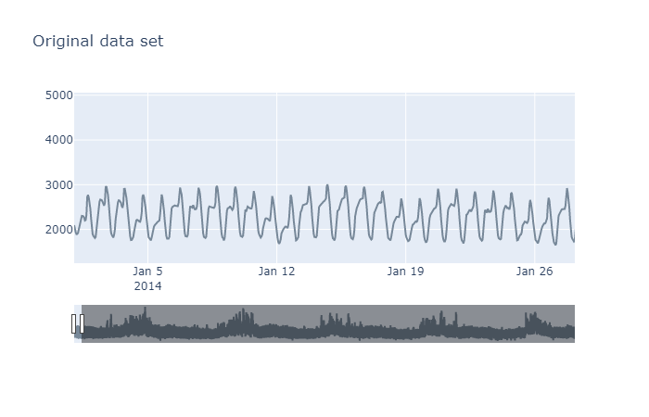
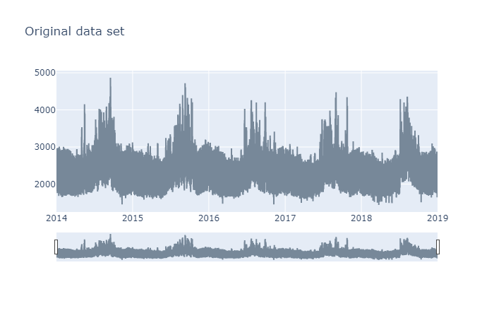
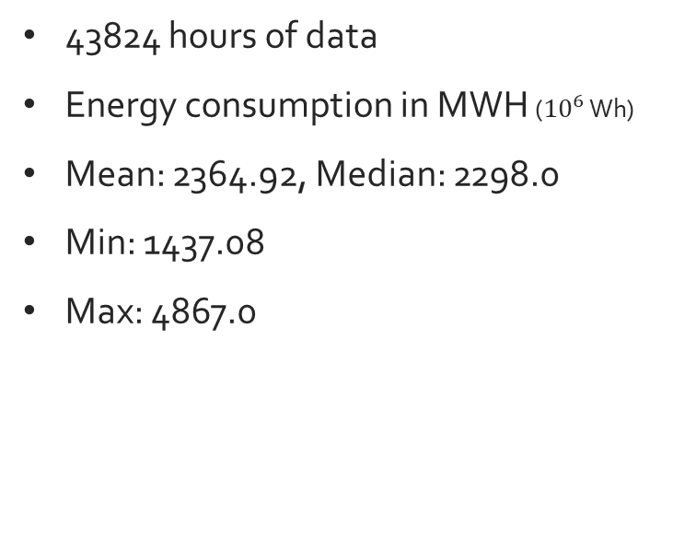
SDGE Energy time series
43824 hours of data
Energy consumption in MWH (${10}^{6}$ Wh)
Mean: 2364.92, Median: 2298.0
Min: 1437.08
Max: 4867.0

Slide 11
Extracting time related features
 | Dates | SDGE | Date | year | month | day | hour | weekday | season | holiday | non_working
0 | 2014-01-01 00:00:00 | 2096.0 | 2014-01-01 | 2014 | 1 | 1 | 0 | Wednesday | winter | 1 | non-working
1 | 2014-01-01 01:00:00 | 1986.0 | 2014-01-01 | 2014 | 1 | 1 | 1 | Wednesday | winter | 1 | non-working
2 | 2014-01-01 02:00:00 | 1936.0 | 2014-01-01 | 2014 | 1 | 1 | 2 | Wednesday | winter | 1 | non-working
3 | 2014-01-01 03:00:00 | 1896.0 | 2014-01-01 | 2014 | 1 | 1 | 3 | Wednesday | winter | 1 | non-working
4 | 2014-01-01 04:00:00 | 1899.0 | 2014-01-01 | 2014 | 1 | 1 | 4 | Wednesday | winter | 1 | non-working
SDGE -> Hourly energy consumption data in MWH
Holiday -> national holidays as per US calendar
Non-working -> Holiday + Weekend

Slide 12
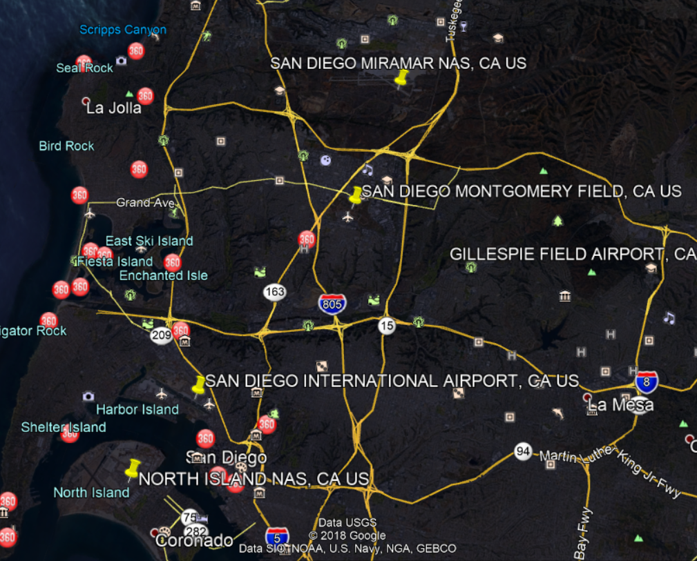
Weather Data
Weather impacts energy consumption, specifically the temperature. Importing 7 minute interval weather data from NOAA’s site.
Yellow pins-> weather stations in San Diego region
For this project choosing the airport data:
More accurate
Not biased by nearby buildings and industries
Notes:
we can always add in data from more stations and use them to see if it helps in the forecast

Slide 13
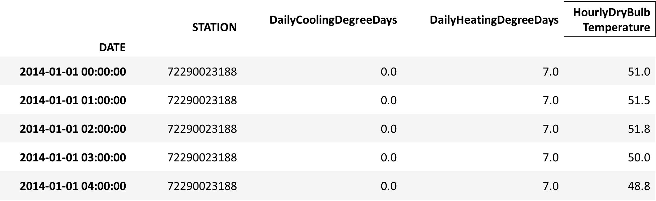
Cleaning and Resampling weather data
Resampling the weather data in hourly intervals and calculating average temperature for each hour.
We'll focus on using only the temperature data but cleaning other columns nonetheless for future purposes.
'STATION’ -> the weather station id
'DATE’ -> the date and time of recording.
'HourlyDryBulbTemperature’ -> the outside temperature in ℉.
Degree days: number of degrees by which the average daily temperature is > 65°F ('DailyCoolingDegreeDays') or < 65°F ('DailyHeatingDegreeDays').
Notes:
Only a few columns from the weather data were imported and used for this project.
'STATION’ -> the weather station id at which the data was recorded. Since we are using airport data we will have only station id.
'DATE’ -> the date and time of recording.
'HourlyDryBulbTemperature’ -> the outside temperature in ℉.
Degree days are defined as the number of degrees by which the average daily temperature is higher than 65°F ('DailyCoolingDegreeDays') or lower than 65°F ('DailyHeatingDegreeDays'). Degree days reflect changes in climate and are used as a proxy for the energy demand for heating or cooling buildings.
Initially we'll focus on using only the temperature data but cleaning other columns nonetheless for future purposes.

Slide 14
EDA

Slide 15
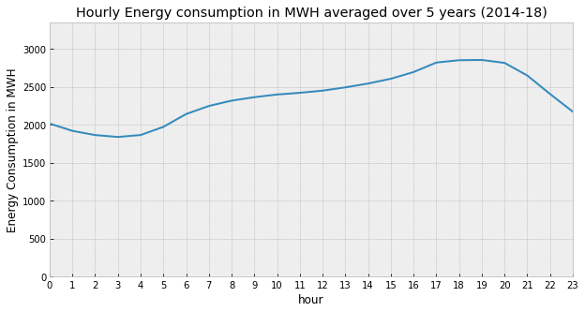
Hourly energy consumption
The load remains low over the night and then starts increasing in the late morning, and continues increasing during the office hours and peaks in the evening when everyone returns home and turns on the electrical appliances.

Slide 16
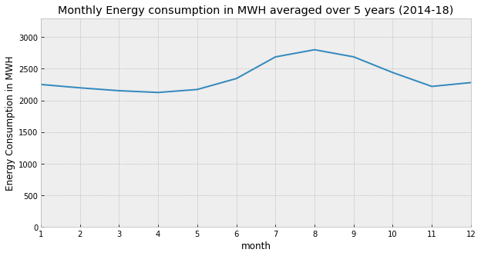
Monthly load profile
Peaks in the summer due to high cooling (air-conditioning) loads caused by high temperatures.

Slide 17

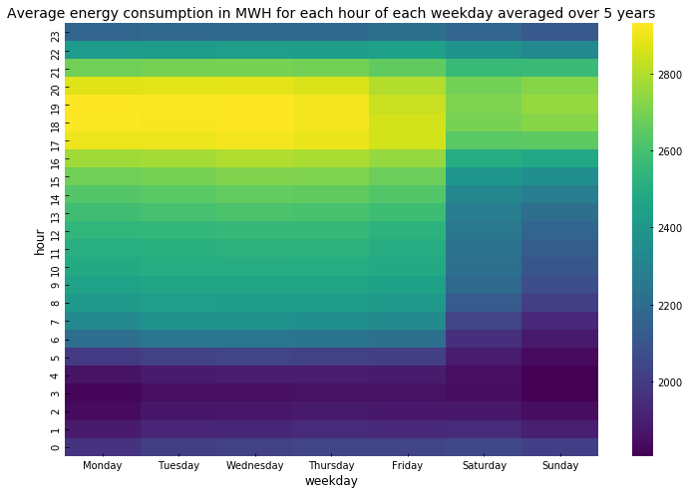
Hourly vs Weekdays
From SDGE's website: "If customers can shift some of their energy use to lower-cost time periods outside 4 p.m. to 9 p.m., they can lower their electricity bills and make better use of cleaner, renewable energy sources, like wind and solar, when they are more available."
Notes:
It can be seen that the average consumption from Monday to Friday is below 2000 in the night and it increases during the day and is at peak (>2800) during the evening time before sliding down again for the night.
And on the weekends the same pattern can be observed but the overall consumption seems lower on weekends than weekdays as expected because most of the commercial buildings don't operate on weekends (also maybe because people go out on weekends and are not usually at home?)
SDG&E began transitioning residential customers to Time-of-Use (TOU) pricing plans in early 2019; a TOU plan is one wherein the utility applies different rates to the customers for different time slots during the day. And in fact, SDGE applies highest rate (peak rate) during 4pm to 9pm to its customers as compared to other hours during the day. From SDGE's website: "If customers can shift some of their energy use to lower-cost time periods outside 4 p.m. to 9 p.m., they can lower their electricity bills and make better use of cleaner, renewable energy sources, like wind and solar, when they are more available."

Slide 18
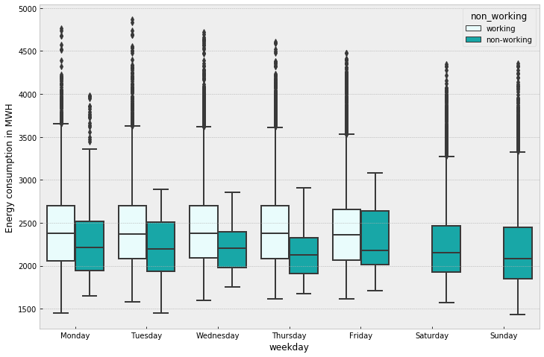
Energy distribution Working vs Non-Working
Notes:
It can be seen that the median energy consumption on working days remains fairly same from Monday to Friday and drops on the weekend as seen before in the heatmap.
Also, if a particular day is a holiday or non-working day (indicated in dark green) the energy consumption is much lower than if the same day was a working day as expected.

Slide 19
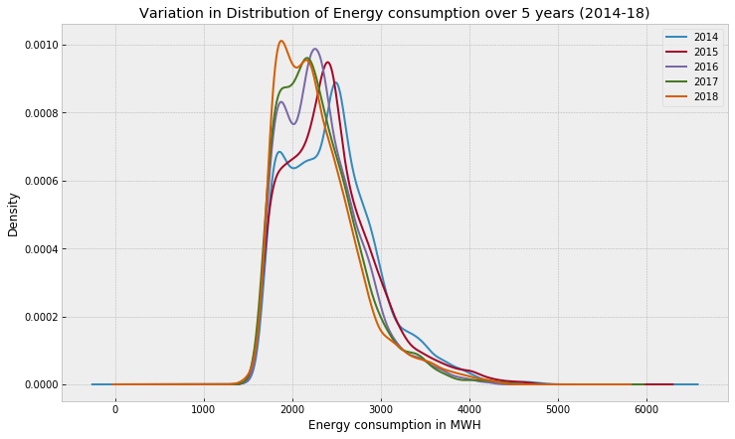
Distribution of energy consumption over different years
Bi-modal. Peak shifts towards left from 2014-18.
Potential reasons:
increasing renewable energy installations at customer sites (called as behind the meter)
Increase in electric efficiency standards of appliances or industry equipment
Battery installations at customer sites

Slide 20
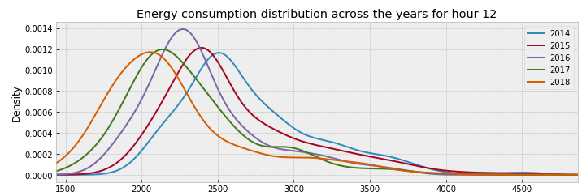
Distribution plots hourly
Left shift is more dominant during the daylight hours of 8am to 5pm.
Addition of more renewables like solar and wind behind the customer meters.
Notes:
If we plot the above distribution plot for each hour (see an example plot below) we can see that the distribution for each hour has shifted towards lower energy consumption values from 2014 to 2018, and this effect is more dominant during the daylight hours of 8am to 5pm.
One of the reasons for this shift during daylight hours can be the addition of more renewables like solar and wind behind the customer meters. We will see later that the solar installations in the SDGE have increased considerably over the last 5 years.

Slide 21

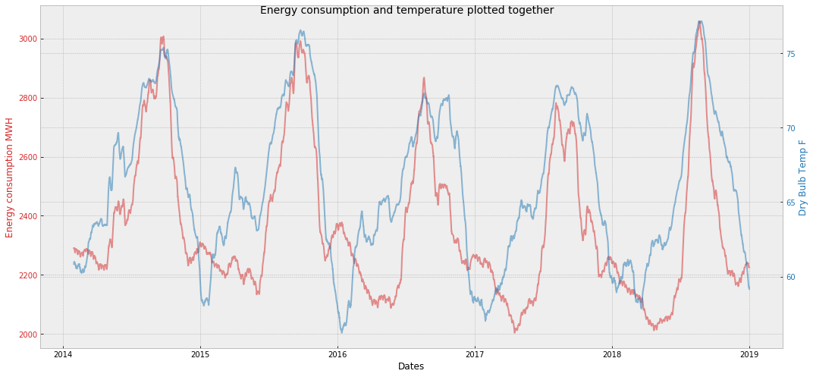
Exploring energy and weather data together
* Rolling monthly mean average of both variables
Notes:
As suspected before, we can see that the energy consumption and temperature do kind of follow each other and seem to have some level of correlation between them.
More importantly we can see that the highest energy consumption values (peak demand) occur at highest temperatures. This, as mentioned before, is the reason of higher cooling loads at higher temperatures.

Slide 22
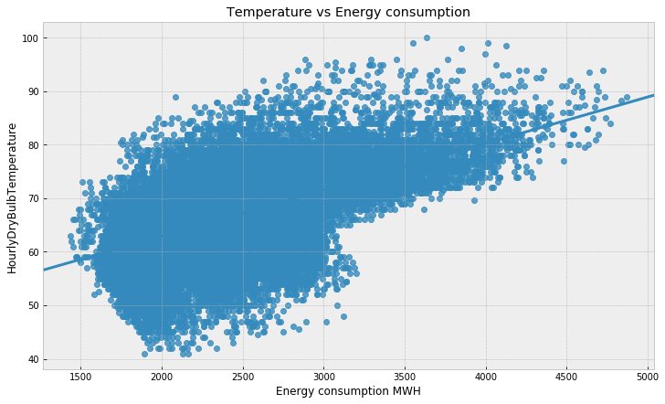
Energy consumption vs Temperature
Observed pearson correlation coefficient between temperature and energy -
for winter 0.32.
for summer 0.65.

Slide 23
Complete the PV import and PV EDA

Slide 24
Intro to TS

Slide 25
Time series info
Stationarity, auto correlation etc.
Decomposition

Slide 26
Trying Simple Lin reg
Explaining what worked and what not

Slide 27
RF

Slide 28
Fourier terms

Slide 29
SARIMAX

Slide 30
FB Prophet

Slide 31
Elastic and RF with Fourier terms

Slide 32
XG Boost

Slide 33
XG Boost + Fb Prophet

Slide 34
Conclusion

